Slide 1
MRI Reconstruction

Slide 2
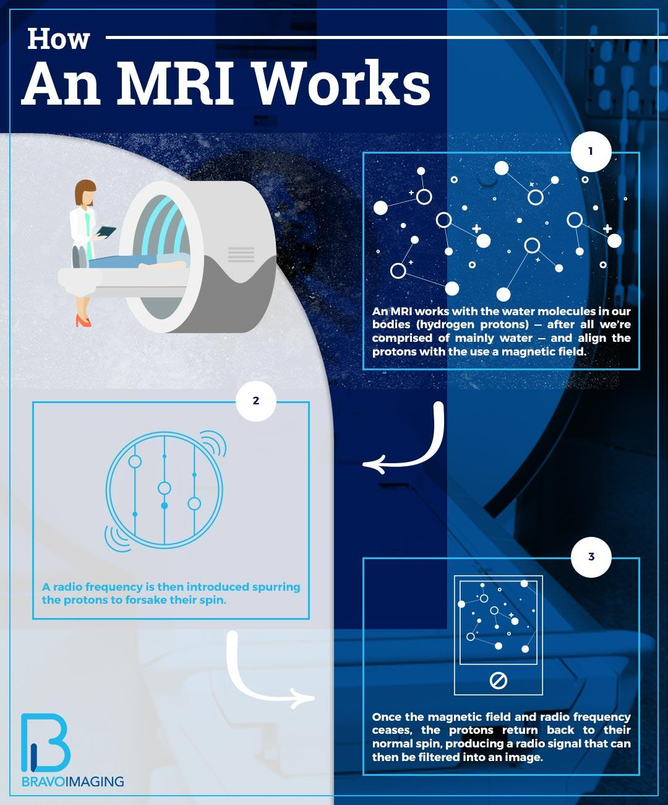
Background
MRI machines don’t actually take pictures: they use magnets and the physical properties of water in our bodies to capture radio-frequency data.
Each radio signal is converted to a pixel in an image using a Fourier transform. By convention, we say that the MRI stores radio-frequency data in k-space, before being converted to an image.
Source: Bravo Imaging

Slide 3
The Problem
Staying still for a long time is hard for
Children
Dementia Patients
Patients with Huntington’s, addictions, etc.
Shorter scan times = more accessible treatment
There are a lot of pixels in a typical MRI image, which means the machine has to send out a lot of radio-frequencies, which takes a long time. This is expensive for hospitals operating MRI machines and uncomfortable for patients, who have to stay still while images are taken.

Slide 4
Potential Solution
What if, instead of measuring every value in k-space, we only directly measured a subset of them?
Quicker scans, but more blurry images
Can we can reconstruct a partially formed MRI image using optimization?
Quick scans with more detailed images

Slide 5
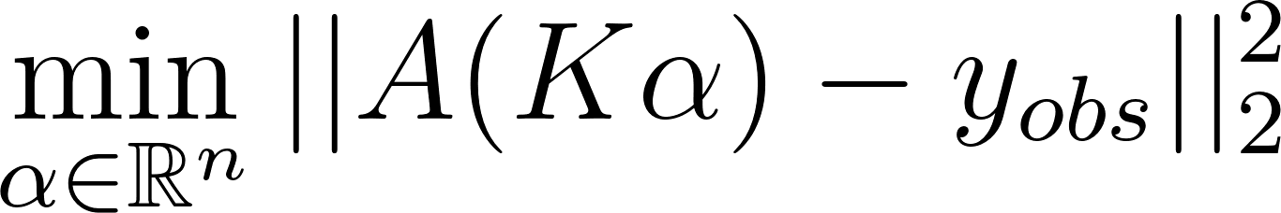
Mathematics
A = MF
M = Diagonal Matrix (entries are 1 if frequency is being measured, 0 if not)
F = Discrete Fourier Transform
Given observed undersampled k-space data y_obs, we are looking for $\alpha$ that solves
There are many possible solutions, so we restrict the reconstruction to a class of kernel basis functions for uniqueness. We use Gaussian kernels to impose smoothness.

Slide 6
Implementation
Data: UPenn-GBM Cancer Imaging Archive. Selected target image.
Create kernel basis & lots of data preparation
Simulate the under-sampling of frequencies: ‘masking’ the data by adding a filter to only show low-frequency waves.
Solve: Using an Adam (Adaptive Moment Estimation) optimizer.
Validate: (1) compare reconstructed image to original MRI target image and (2) measure loss over iterations.

Slide 7
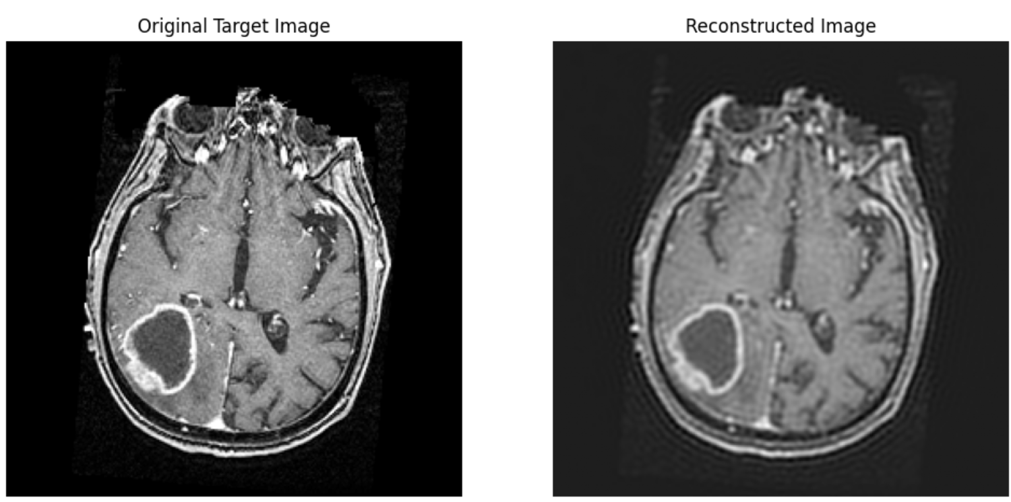
Results
Pro:
Working prototype w/real data
Con:
Blurry image
No frame of reference for accuracy

Slide 8
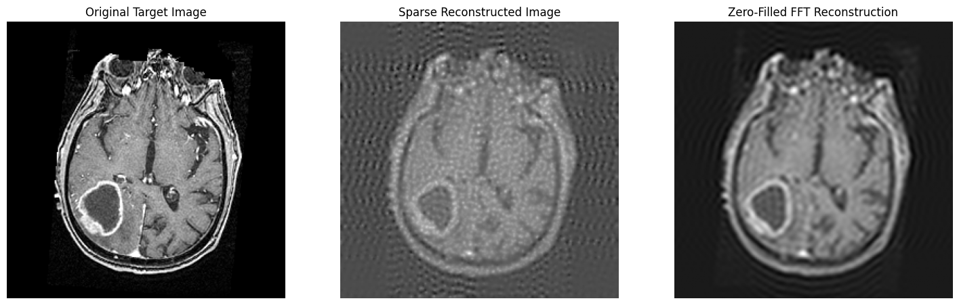
Comparing Kernels vs. Baseline Reconstruction
Metric | LaPlacian Kernels | Gaussian Kernels | Zero-Filled FFT
MSE | 0.0186 | 0.00529 | 0.010049
PSNR | 17.30 dB | 22.78 dB | 19.98 dB
Original Image
Laplace Reconstruction
Gaussian Reconstruction
Zero-filled FFT Reconstruction
Gaussian kernel reconstruction provides highest clarity.

Slide 9


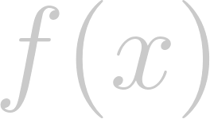


Another Baseline: The Traditional Approach
Modern MRI reconstruction often uses learned priors (CNNs/diffusion models)
Trained a small CNN:
3 layers, 64 channels, 3x3 kernels (standard, small)
Input: undersampled MRI slice
Predicts a correction: where
is final reconstructed image
is learned correction
is the undersampled input
Used L1 loss (common in image restoration tasks):
Notes:
Undersampled image already retains a lot of its structure, so the network focuses on cleaning it up rather than completely restructuring it

Slide 10
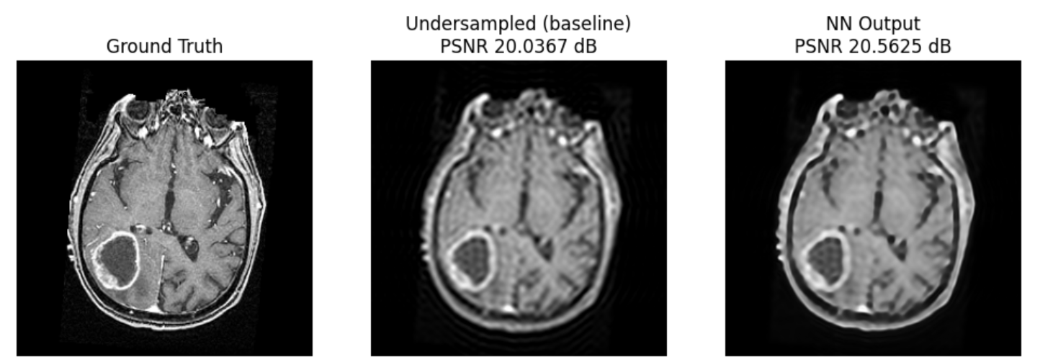
Neural Network Baseline Results
Gaussian kernel still achieves highest PSNR, implying the kernel method is competitive to traditional, learned methods.
Notes:
To evaluate the kernel approach, we explore a learned baseline which is of typical use in the field.
CNN improves over zero-filled FFT and the undersampled image but we can see that kernel choice MATTERS. Gaussian kernel achieved highest PSNR, showing that the kernel method is competitive with learned methods

Slide 11
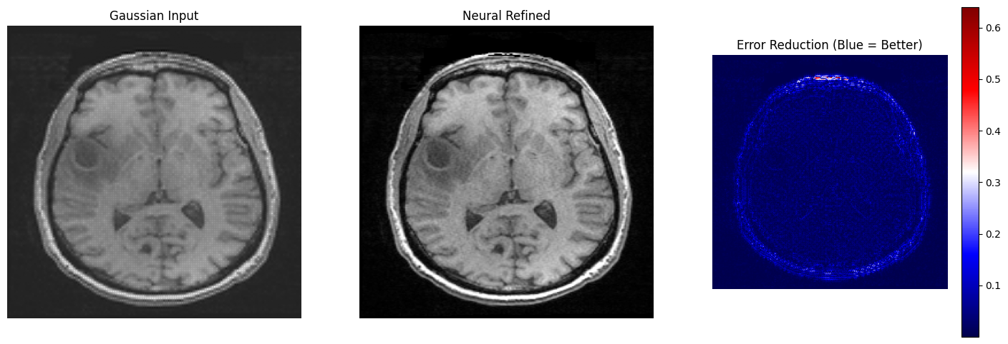
Warm-Start Neural Network
Again, used kernel reconstruction as input to a neural network but only let the neural network fill in the directions the kernel did not already smooth. We also changed the neural network architecture to U-Net, rather than ReLU which is more common in medical applications.

Slide 12
Warm-Start Neural Network Results
 | Gaussian Reconstruction | Warm-Start NN Reconstruction
PSNR | 19.581 dB | 137.75 dB
MSE | 0.011 | 0
SSIM | 0.605 | 1.0
Achieved a perfect reconstruction of the desired image!

Slide 13
Super Resolution Convolutional Neural Network (SRCNN)
SRCNN is a three-layer CNN for single-image super resolution. Instead of applying kernels, we used SRCNN to reconstruct the entire slice. It made the following improvements:
 | Kernel Optimizer (Gaussian) | SRCNN | Improvement
PSNR | 28.78 dB | 37.74 dB | 8.96 dB
SSIM | 0.8786 | 0.9534 | 0.0748

Slide 14
Next steps
Train / test across multiple slices: so far, we have mostly been testing on a single slice to show proof of concept. Now we need to test across multiple slices
Diffusion models: see if replacing the warm-start neural network with diffusion model improves reconstruction since diffusion models used in image generation
Multi-image super resolution: add context by considering the slices before/after the slice that is being reconstructed
Images & Videos: try our reconstruction approaches on various images and videos

Slide 15
Lightning Presentations: MRI Reconstruction

Slide 16
Problem Statement & Motivation
There are a lot of pixels in a typical MRI image, which means the machine has to send out a lot of radio-frequencies, which takes a long time. This is expensive for hospitals operating MRI machines and uncomfortable for patients, who have to stay still while images are taken.
Shorter scan times = more accessible treatment
Notes:
MRI scans are expensive to operate for hospitals and uncomfortable for patients, who have to stay perfectly still while the scan is being taken. We want to minimize the amount of time that MRI takes for both patient comfort and to reduce cost of care. MRIs use the physics of water in our bodies to gather radio-frequency data that is converted to an image by an inverse Fourier transform. This data is stored in a frequency space that we refer to as k-space, which contains the Fourier coefficients of the MRI image. It takes a long time to measure every radio-frequency, so in practice MRI data is undersampled, meaning that only a subset of k-space values are collected and some information is missing. This means that reconstruction is an optimization problem, where we try to find an image whose Fourier transform matches the measured k-space data at the sampled locations.

Slide 17
Technical Approach
A = MF
M = Diagonal Matrix (entries are 1 if frequency is being measured, 0 if not)
F = Discrete Fourier Transform
Given observed undersampled k-space data y_obs, we are looking for 𝛼 that solves
There are many possible solutions, so we restrict the reconstruction to a class of kernel basis functions for uniqueness. We start with Gaussian and LaPlacian kernels.

Slide 18
Initial Results pt. 1
Metric | LaPlacian Kernels | Gaussian Kernels | Zero-Filled FFT
MSE | 0.0186 | 0.00529 | 0.010049
PSNR | 17.30 dB | 22.78 dB | 19.98 dB
Original Image
Laplace Reconstruction
Gaussian Reconstruction
Zero-filled FFT Reconstruction
Gaussian kernel reconstruction provides highest clarity.

Slide 19
Initial Results pt. 2
Modern MRI reconstruction often uses learned priors (CNNs/diffusion models)
Trained a small residual CNN, then reconstructed the same slice we used the kernel method on
Gaussian kernel still achieves highest PSNR, implying the kernel method is competitive to traditional, learned methods.
Notes:
To evaluate the kernel approach, we explore a learned baseline which is of typical use in the field.
CNN improves over zero-filled FFT and the undersampled image but we can see that kernel choice MATTERS. Gaussian kernel achieved highest PSNR, showing that the kernel method is competitive with learned methods

Slide 20
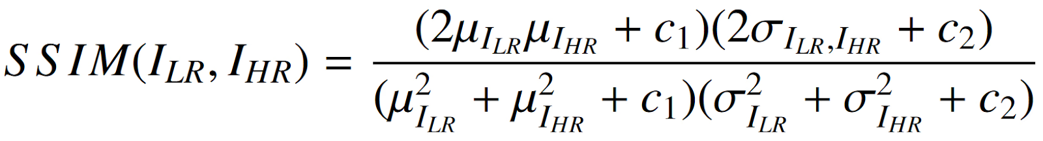
Next Steps
Moving toward more general image reconstruction/upscaling due to difficulty in determining medical benchmarks
Combining the kernel approach with neural networks
Use kernels to get a smooth reconstruction
Feed the reconstruction into a neural network
Network learns the residual and works as a residual corrector
Can only modify the unobserved regions of k-space
Using the Structural Similarity Index as another metric of success
Explore different deep learning and neural network upsampling strategies (Pre, Post, and Progressive)
Notes:
Kernels handle local smoothness and stability. Diffusion handles anatomical realism and texture

